Slide 1

COMP1004 Assessment Presentation: A Tale of Tales
A PowerPoint created and presented by Michael Hooper

Slide 2
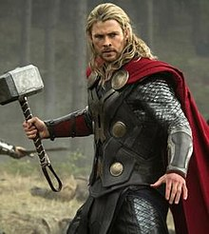
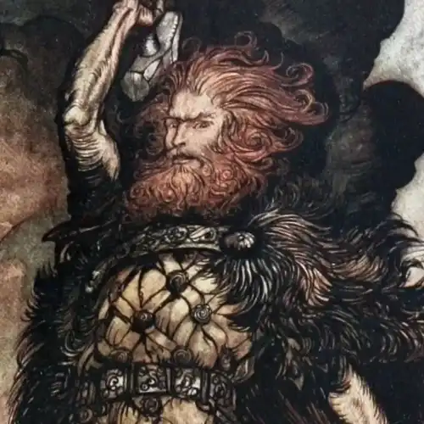
Project Vision and Background
My project and the vision surrounding it.
The recognition and knowledge of mythology in modern day.
A Tale of Tales
The importance of belief and stories.
A quote from Neil Gaiman.
Stories I like and my goal with this game.
Immortality and other Hypertext Fiction games

Slide 3
Project Vision and Background cont.
Considerations for this project.
Social and ethical issues.
Copyright
Accessibility

Slide 4
Planning and Sprint Sessions
The plan for my project.
The Agile ideology of the SDLC.
My Plan for how it works and perhaps looks.
My Sprint Sessions.
What was discussed.
My goals made during the session.

Slide 5
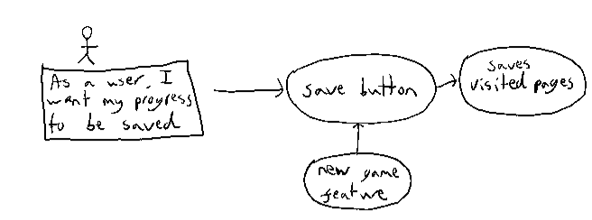
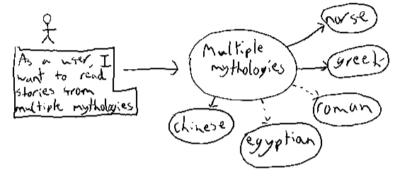
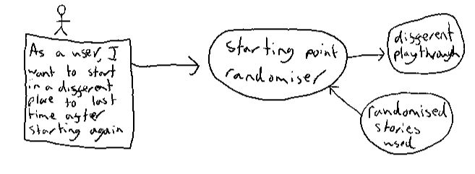
User Stories

Slide 6
Issues and Challenges Faced
Coding Languages.
HTML
CSS
JavaScript

Slide 7
Thank You for Watching

